Slide 1

Phonics Evening
Wednesday 24th April 2024

Slide 2
Our Aim:
All children are confident readers who read for pleasure.

Slide 3

Notes:
The research shows that the children who read for pleasure, are creating the best life chances for themselves.

Slide 4
Phonics
Recommended as the first strategy that children should be taught in helping them learn to read.
From learning letter sounds to reading fluently. Phonics is a big part of school life!
Daily lesson in Key Stage 1.
It progresses from Phase 1 through to Phase 5.
Notes:
The start of that journey is Phonics.
Phonics is how we teach early reading.

Slide 5

What is phonics?
How most children learn to read and spell.
Making the connection between sounds (phonemes) and the letters that are used to write them down (graphemes).
To be able to decode the English language.

Slide 6
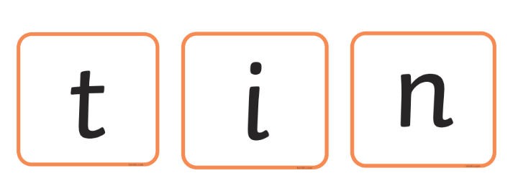
For example...
Notes:
When we read we see these letters written down, we turn them back into sounds.
Then we join the sounds together (blending) to read the word t - i - n...tin

Slide 7

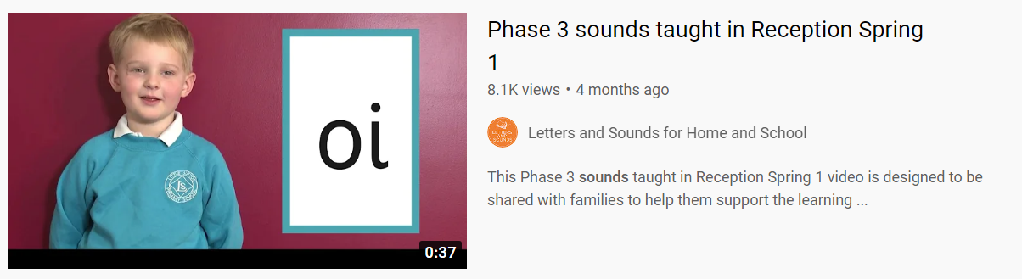
Pure sounds

Slide 8
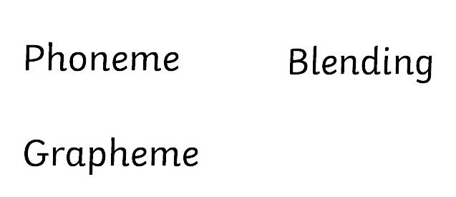

Digraph ch
Trigraph igh
Split digraph a-e

Slide 9
Phase 1
In Phase 1 phonics, children are taught about:
Environmental sounds
Instrumental sounds
Body percussion (e.g. clapping and stamping)
Rhythm and rhyme
Alliteration
Voice sounds
Oral blending and segmenting (e.g. hearing that d-o-g makes ‘dog’)
This phase is intended to develop children’s listening, vocabulary and speaking skills.

Slide 10
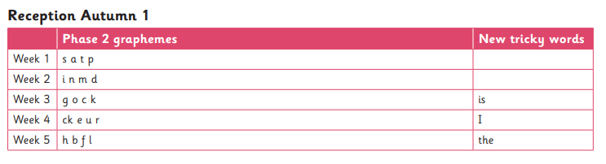
Phase 2
In Phase 2, children begin to learn the sounds that letters make.
These sounds are called phonemes.
There are 44 sounds.
In Phase 2, children focus on learning the 19 most common single letter sounds.
By the end of Phase 2 children should be able to read some words
*vowel-consonant (VC) it
*consonant-vowel-consonant (CVC) words pig
Notes:
Reception – Aut 1, Aut 2 = Phase 2

Slide 11
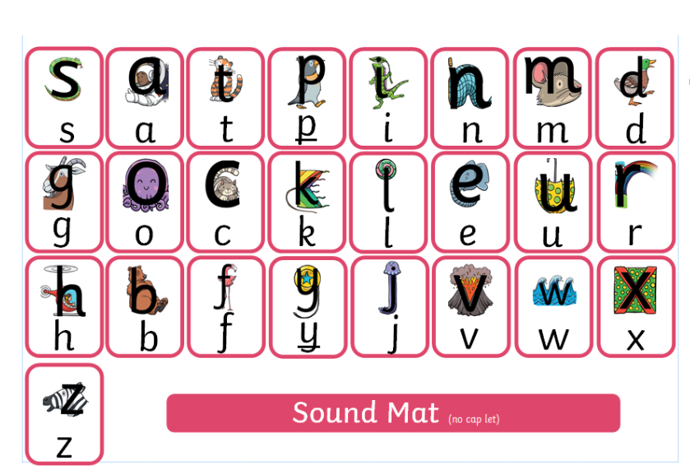
Phase 2
When children are taught a letter, they learn a phrase to help them remember.
Notes:
Reception – Aut 1, Aut 2 = Phase 2
Each letter that they learn to form has a Little Wandle formation phrase that we use
A – around the astronauts helmet and down to space

Slide 12
Tricky Words
The children will use the 44 sounds to read most words.
To get children reading quickly, we teach them the most common way each sound is spelled first.
There are some words with spellings that cannot be decoded.
We teach these as ‘Tricky Words’ and we review and teach a new one every day.

Slide 13


Slide 14
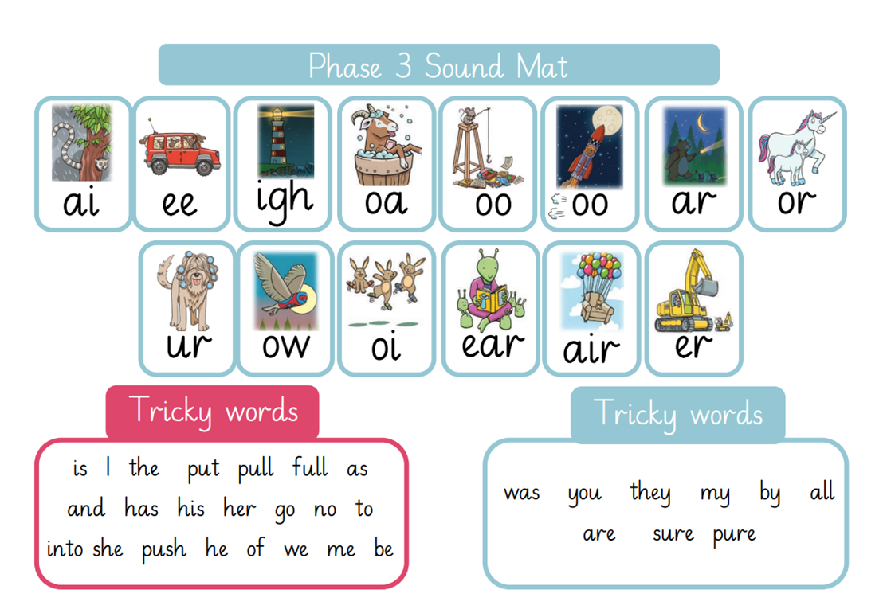
Phase 3
Phase 3 introduces children to the remaining, more difficult and/or less commonly used phonemes.
These are mainly made up of two letters such as /ch/, /ar/, /ow/ and /ee/.
Notes:
Reception, Spring 1, Spring 2

Slide 15

Phase 4
By now, children should be confident with each phoneme.
Consolidating and refining their knowledge, introducing more spelling patterns and tricky words, and increasing vocabulary.
Practise reading and spelling longer words
CVCC words (‘bump', 'nest', ‘belt,’ ‘milk’, etc)
Practise reading and spelling high frequency words.
Practise reading and writing sentences.
Learn more tricky words, including ‘have,’ ‘like,’ ‘some,’ ‘little’.
Fluency should be increasing with less sounding out.
Notes:
Reception Summer 1 and 2

Slide 16
Phase 5
Children learn different ways of spelling each sound and alternative pronunciations for these: for example, learning that the grapheme ‘ow’ makes a different sound in ‘snow’ and ‘cow’.
They should become quicker at blending, and start to do it in their heads.
They learn about split digraphs such as the a-e in ‘name.’
They will learn more tricky words, including ‘people,’ ‘water’ and ‘friend’.
Notes:
Year 1 Autumn Term, review Phase 3 and 4 and start Phase 5.

Slide 17
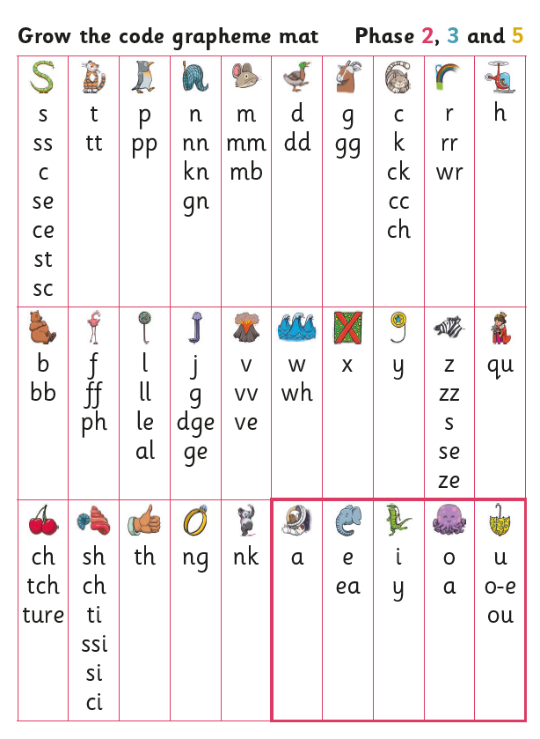
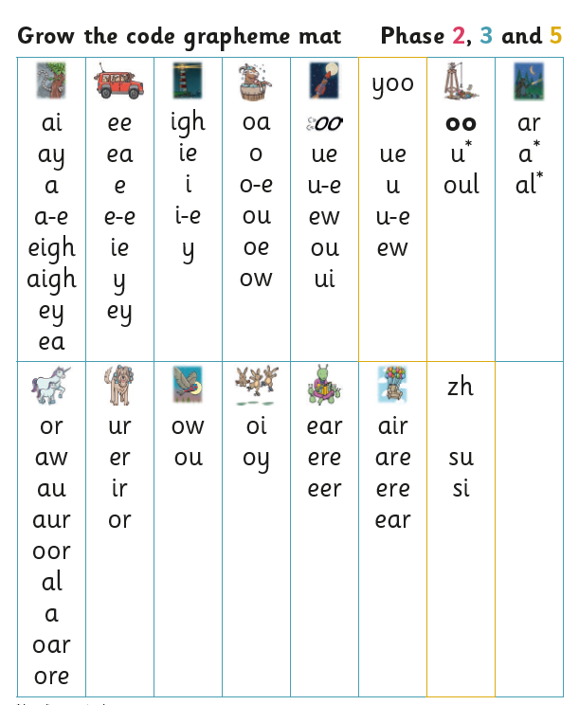
Phase 5
Notes:
Year 1 Autumn Term, review Phase 3 and 4 and start Phase 5.

Slide 18
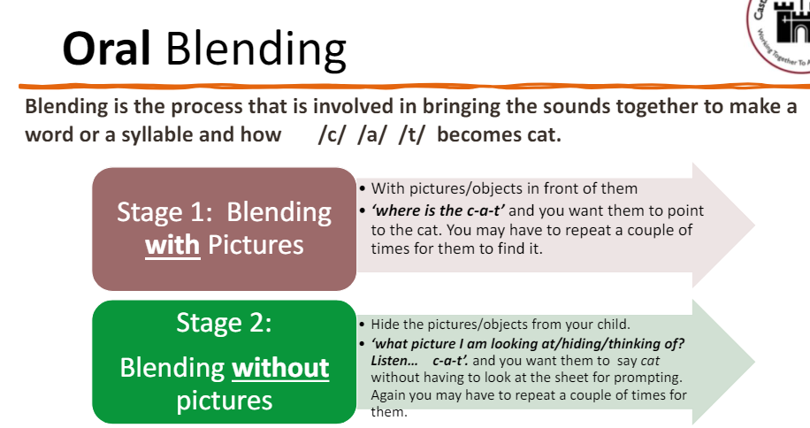
Reading and phonics at home
Play I-spy
Word hunt
Read their book
Use…
say the sounds
blend the sounds
Notes:
How to help your ch

Slide 19
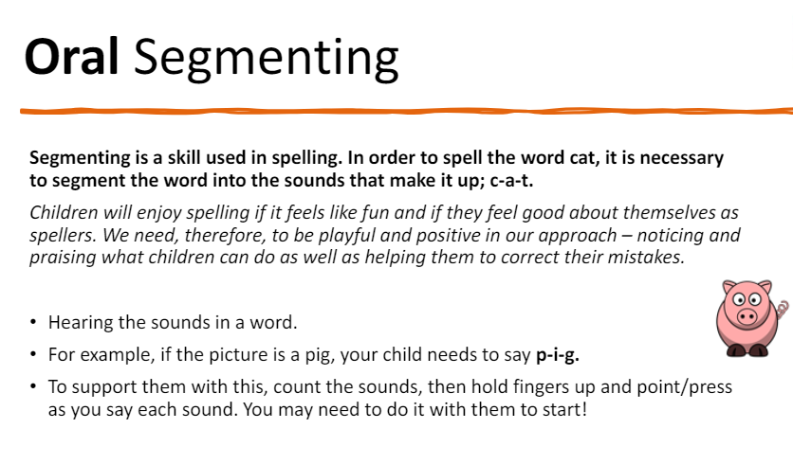
Reading and phonics at home
Post-it note passcodes
Make graphemes using playdough, paint, water, sand etc.
Tricky word snap
Notes:
How to help your ch

Slide 20
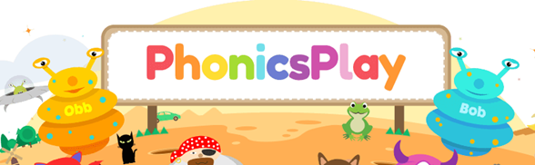
We also have a subscription to Phonics Play where you can play phonics games with your child at home.
Username: fernwoodinf1
Password: woodfern

Slide 21

Notes:
Dragon’s den – real or fake? Have to read the word themselves
Oral blending

Slide 22

Notes:
Rocket rescue – listen to the word that is spoken and type it in.
Oral segmenting

Slide 23
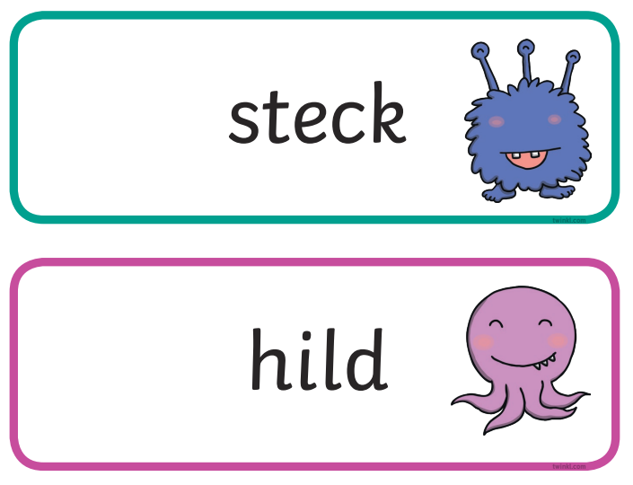
Phonics screener
In June, Year 1
Read 40 words to an adult 1:1
Some are alien words, some are real words
Week commencing 10th June
Notes:
1:1
Pass rate is normally around 32.
Week commencing June 10th 2024

Slide 24
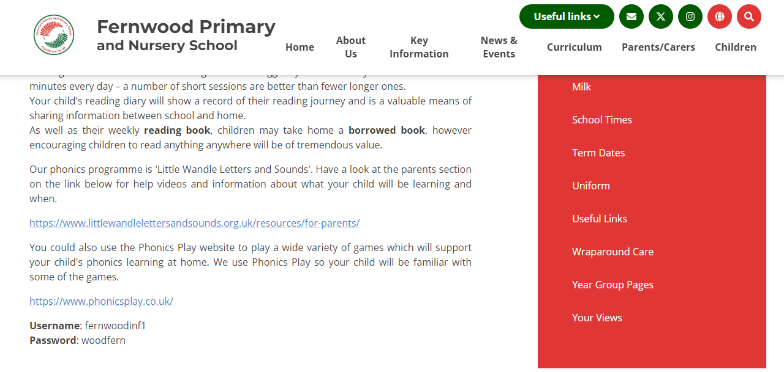
Notes:
For parents/carers
Helping at Home
Little Wandle link
Phonics Play link

Slide 25
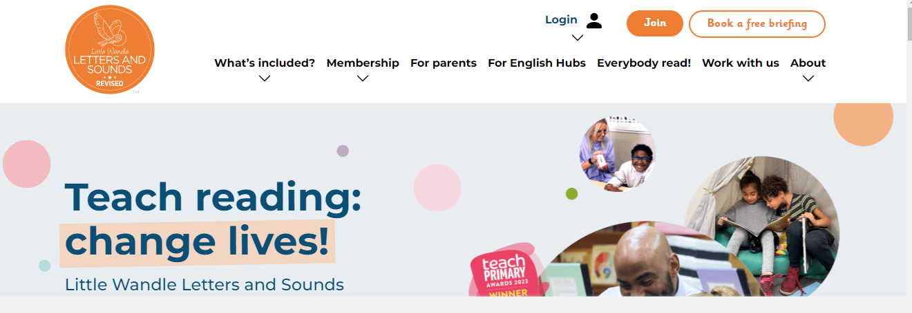
Notes:
Show parents round the website.

Slide 26
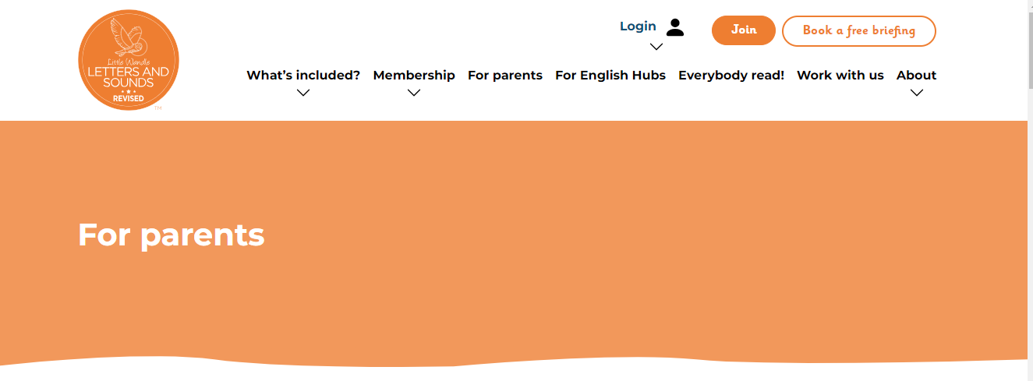
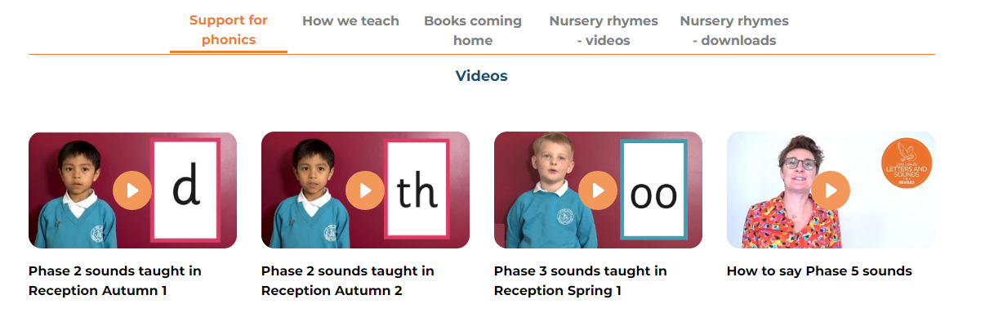
Notes:
Pure sound videos very good.

Slide 27
Thank you
Notes:
Katie

